Slide 1
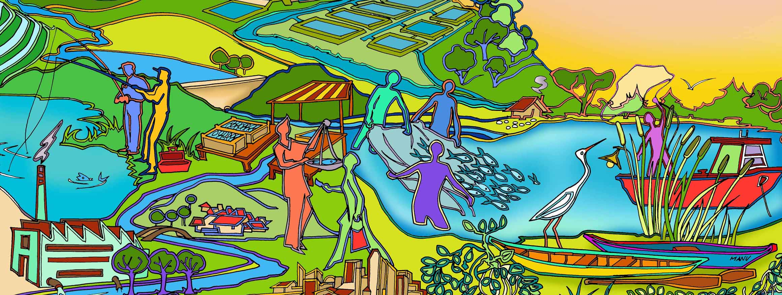
Session 3
The why and what of EAFm?
Essential EAFm training
Date |Place

Slide 2
Session objectives
After this session you will be able to:
Describe what EAFm is
Explain the benefits of using an EAFm
Explain how EAFm fits with other approaches
Recognize the difficulty in dealing with multiple societal objectives
Notes:
Self explanatory

Slide 3
What is EAFm?
EAFm is the ecosystem approach (EA) applied to fisheries management (Fm)
EA + Fm = EAFm
i.e. a practical way to implement sustainable development and sustainably maximize the ecosystem benefits of a fishery system

Slide 4
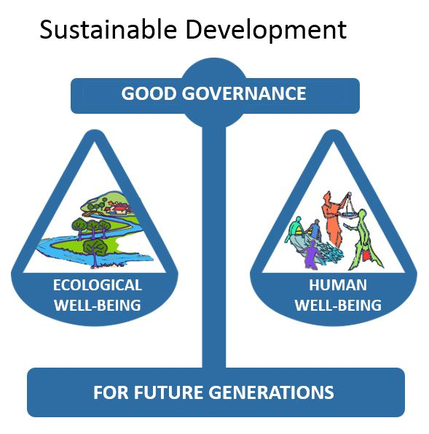
EAFm helps to find the balance
Notes:
As with Sustainable development, EAFm can be thought of finding a BALANCE between human well-being and ecological well-being through good governance for future generations.

Slide 5
Components of EAFm
EAFm
Ecological well-being
Good governance
Human
well-being
Note: Ecological well-being = fish + environment
Notes:
Remember: as with Sustainable Development, EAFm has the same three components. Note that the ecological component has 2 sub-components – fish and the environment
See Participant Handbook Module 3 Figure 3.1 for fisheries example of the 3 components

Slide 6
EAFm builds on existing fisheries management : “the move towards EAFm”
EXISTING
Fish focused
Target species
Production driven
Managed through control of fishing
Government driven
EAFm
All aquatic species
Considers habitats
Fishery impacts on the ecosystem
Threats to the fishery from external factors
Good governance/
Participatory/co-management
Socio-economic benefits
EA
Integrated management across sectors
Multiple use management
Notes:
Moving from left to right we can see that EAFm, therefore, is a broadening of existing (or conventional) fisheries management that focused mainly on target species (species that could be eaten or sold). EAFm is the sectorial version of EA/EBM.
We, therefore, talk about “Moving towards EAFm”.
Multi-sectoral e.g. Landscape management or integrated water management (EA/EBM) is also often aspired to.
Refer to Participant Handbook Module 3, detailed Table 3.2 Moving towards EAFm continuum.

Slide 7
Why EAFm?
Promotes broader consideration of the links between components in an ecosystem and fisheries;
Facilitates trade-offs between different stakeholder's priorities, balancing human and ecological needs
Increases stakeholder’s participation – better communication and trust
Notes:
Earlier forms of fishery management, have not achieved sustainable fisheries or equitable outcomes.
Reinforcing the benefits of EA (discussed in session 2), EAFm has a number of benefits for fisheries, including:
Promotes broader consideration of link between components in an ecosystem and fisheries;
Facilitates trade-offs between different stakeholder's priorities, balancing human and ecological needs;
Increases stakeholder’s participation and most importantly, promoting better communication and trust
Refer to Participant Handbook Module 3, Table 3.1: Features of EAFm, which outlines in more detail how EAFm specific features can help address the threats and issues identified earlier.

Slide 8
Why EAFm? continued…
Enables recognition of larger-scale, longer-term issues and their solutions
Increases support for better governance
  Can lead to better compliance and enforcement
Reduces conflicts, especially between different fishery sub-sectors and other sectors
Helps access to financial resources for fisheries
  Good planning and momentum fosters support from governments, donors and NGOs
Notes:
Continuing on from the last slide, EAFm has a number of benefits for fisheries, such as enabling recognition of larger-scale, longer-term issues and their solutions, reducing conflict, and most importantly unlocking finances,.
Refer to Participant Handbook Module 3, Table 3.1: Features of EAFm, which outlines in more detail how EAFm specific features can help address the threats and issues identified earlier.

Slide 9
Other management approaches
Co-management:
a partnership arrangement between government and other stakeholders for management
typically a key part of EAFm
Freshwater Conservation Areas/Zone (FCA/Zs):
a clearly defined area to achieve conservation of nature (fish, aquatic resources and often water birds), with associated ecosystem services and cultural values
another important tool for EAFm
Notes:
Many of you will be familiar with some or all of these management approaches.
Here are 2 more approaches that participants may have some knowledge of.
NB. FCA/Zs are a tool for EAFm, but do not equate to EAFm, as they cannot address all issues/elements that EAFm has to include, but may form part of a set of tools to implement an EAFm.

Slide 10
Other management approaches (continued)
Integrated water (resource) management (IWRM):
an ecosystem approach to managing a watershed or irrigation system
links with EAFm in rivers, watersheds and irrigation command areas.
Integrated Land Management (ILM):
planning that allocates user access based on the spatial and temporal distribution of human activities
an important tool for EAFm (zoning)
Notes:
There are a lot of other approaches to management that all have the same overall goals and principles. Here are 2 approaches that participants may have some knowledge of.
Continue on next slide.

Slide 11
EAFm complements other approaches
Integrated Water Resources Management
Integrated Land management
EAFm
Fishery
co-management
Freshwater conservation Areas
Notes:
EAFm fits in with approaches that you may know:
The all-encompassing circle is IWM/ ILM.
Within this we have:
EAFm
Co-management
Freshwater conservation areas
All of these approaches recognize that management must deal with broad ecosystem management (both natural and human components) and try to optimize the social and economic benefits.
Diagram shows relationships – actual degree of overlap will vary from country to country – but not too extremely, e.g. so that EAFm falls fully within IWM, and co-management is usually fully within EAFm.
Let participants explain why they think that circles should be moved to reflect the situation in their particular country.
Refer to Participant Handbook Module 3, Figure 3.2

Slide 12
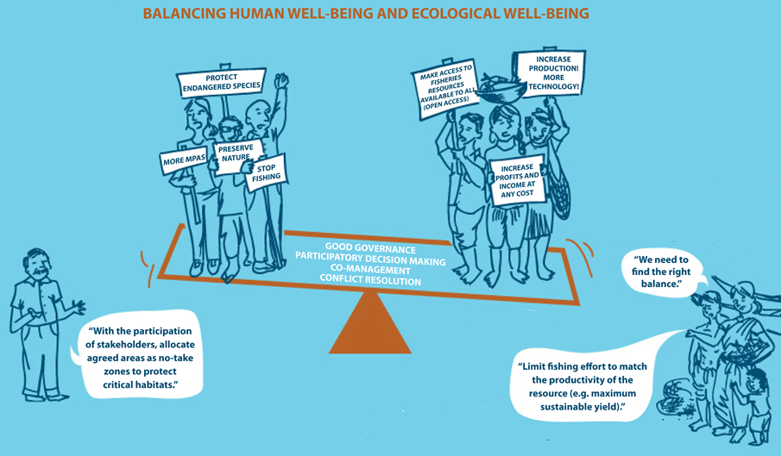
REMEMBER EAFm IS FINDING THE BALANCE
Priority: Ecological well-being
Priority: Human well-being
MORE FCZs
Adapted from ICSF (2013)
Notes:
REMEMBER: EAFm IS FINDING THE BALANCE:
In this picture, we have the PRO-ECOLOGICAL-WELLBEING groups who want to ban fishing, put in more conservation areas and protect endangered species. On the right we have the PRO-HUMAN WELL-BEING groups who want increased fish catches through increased technology, make fishery resources available to everyone and increase profits at any costs.
Under the seesaw we have a balanced solution in the case of participatory use of FCA/conservation areas/closed seasons and and limiting fishing effort.

Slide 13
Key messages
EAFm is simply applying EA to fisheries
EAFm has 3 components:
  Ecological well-being
  Human well-being
  Good governance
EAFm is all about finding the balance
Many benefits of using an EAFm
Builds on existing management (i.e. we move towards EAFm)
EAFm fits in with and overlaps other forms of integrated management (e.g. IWRM)
Notes:
Self explanatory

